Slide 1
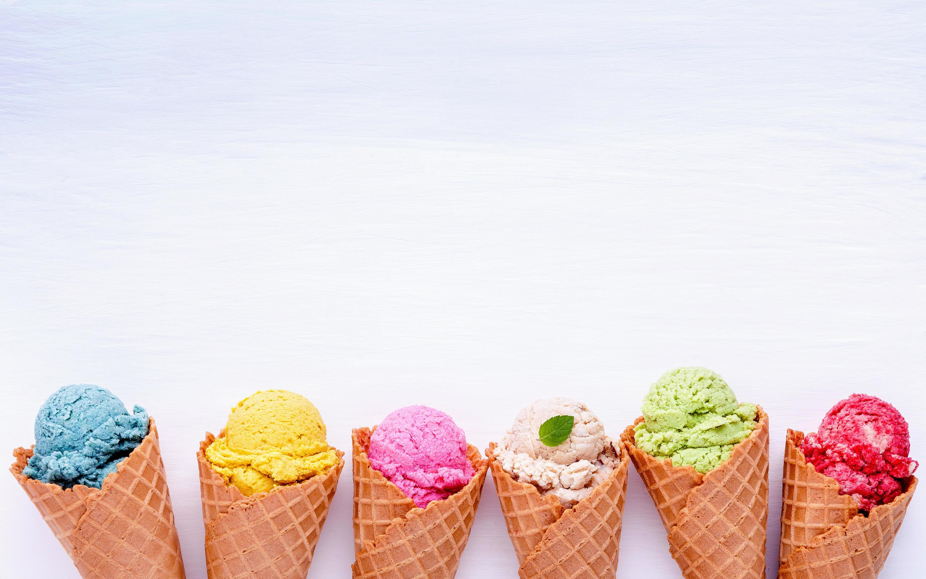
The 17 of February. Classwork.
th

Slide 3
Let’s have a break!!!
Stand up!
Hands up!
Hands downs!
Sit down!

Slide 4
Ex. 1
1. Do you like ice cream?
2. Where do you buy it?
3. Do you eat it in winter?
4. What’s your favourite flavor?
5. Can you make ice cream?

Slide 5
ICE CREAM MENU
Vanilla
Caramel
Coffee
Banana
Chocolate
Mint
Mango
Strawberry

