Slide 1

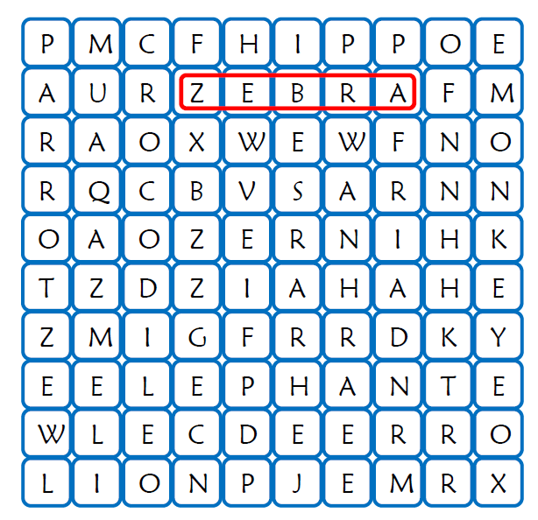
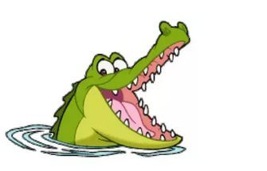
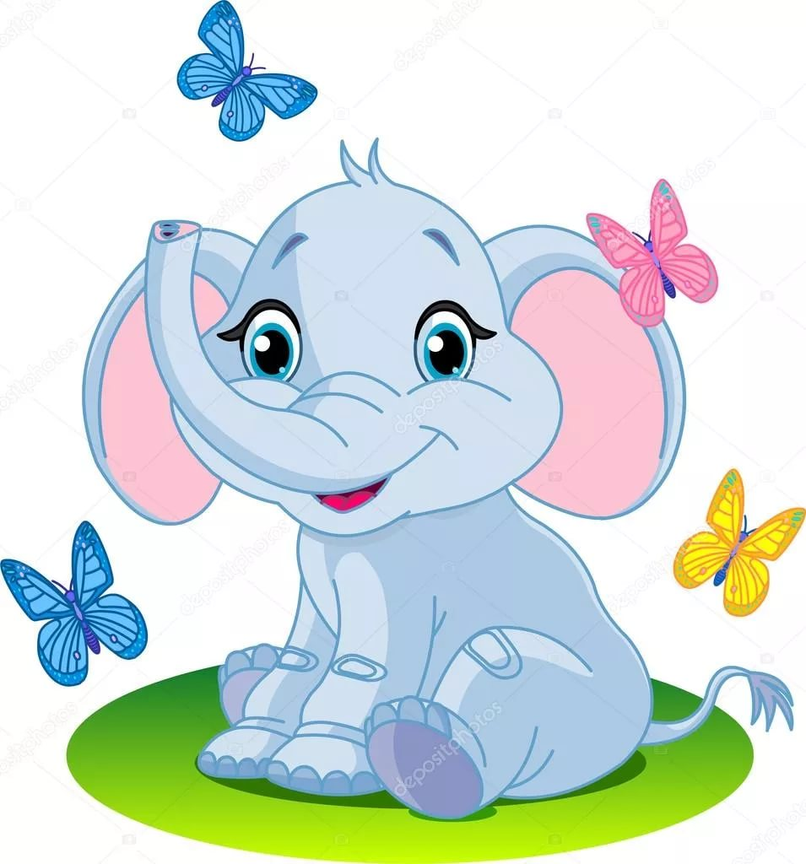
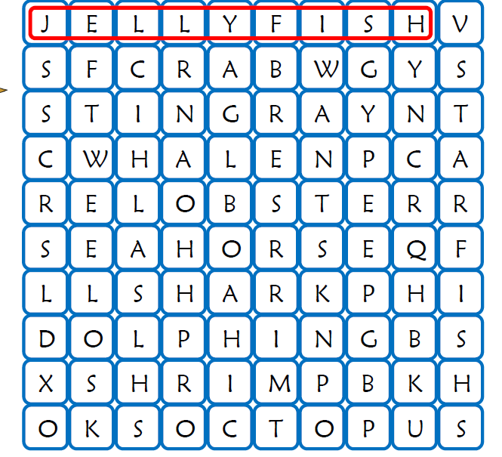
LET’S PLAY !

Slide 2

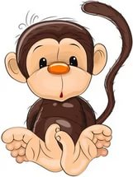


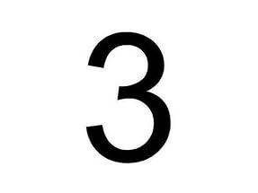
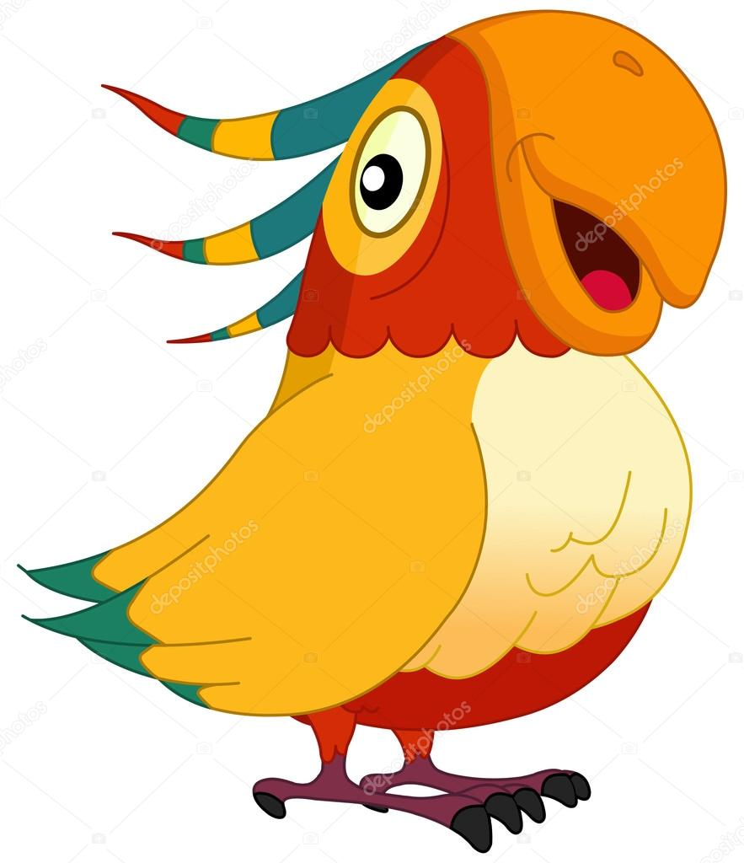
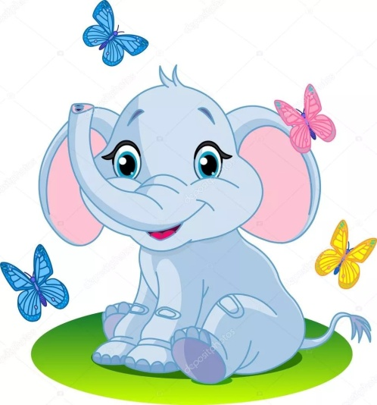
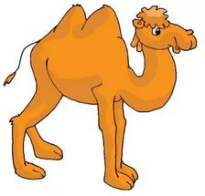
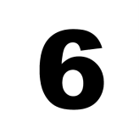
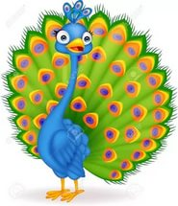


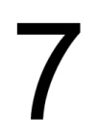
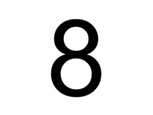

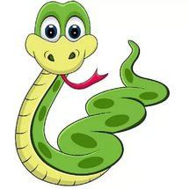

Slide 3
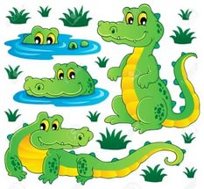

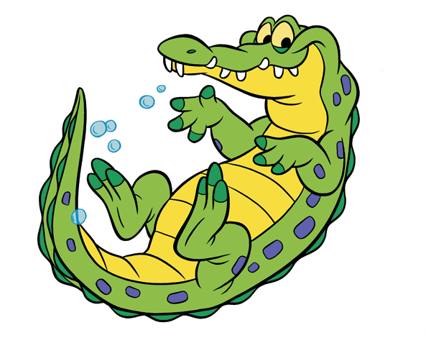

Slide 4
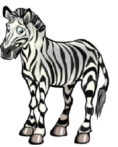

Slide 5
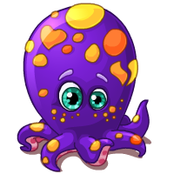
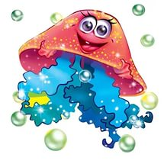


Slide 6
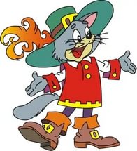

Slide 7
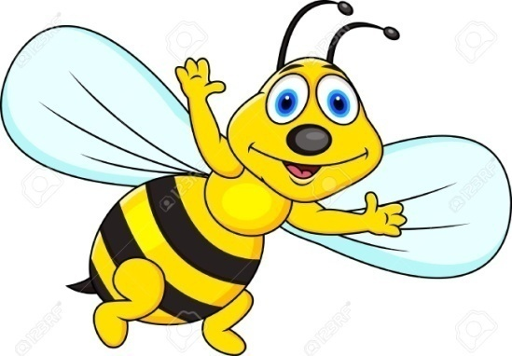
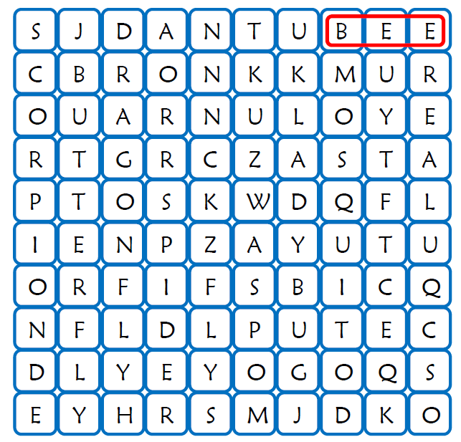

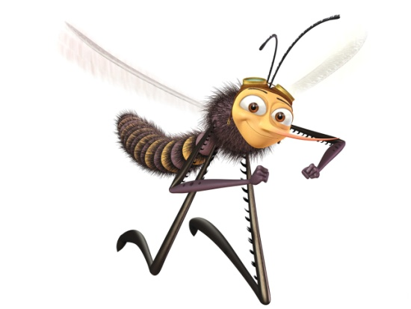

Slide 8
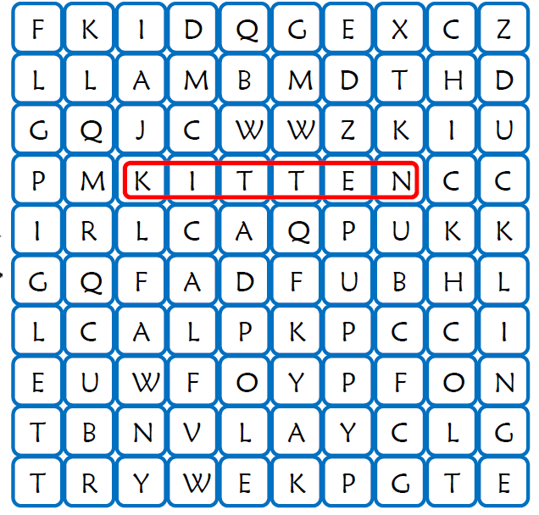
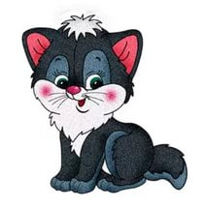

Slide 9











Slide 10
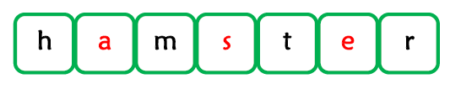







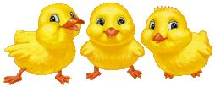


Slide 11
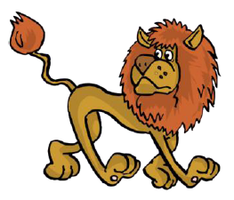
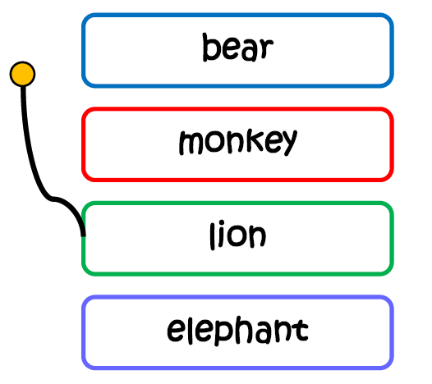
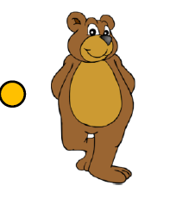
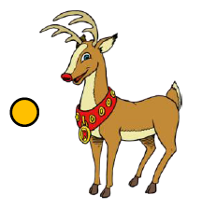


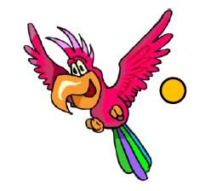
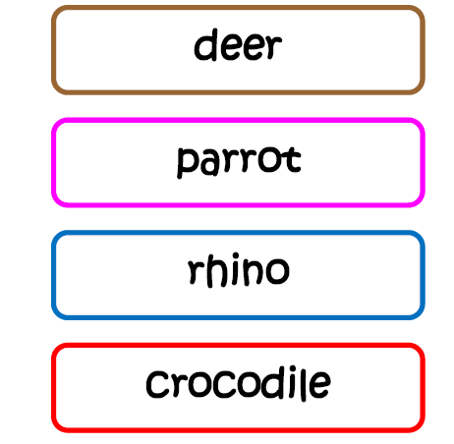
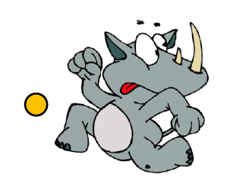
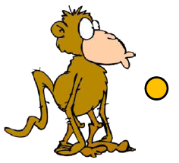

Slide 12
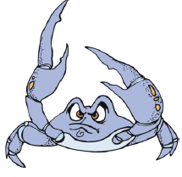
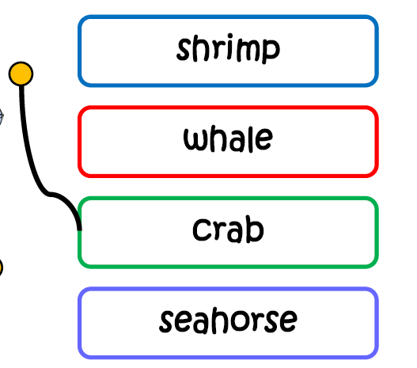
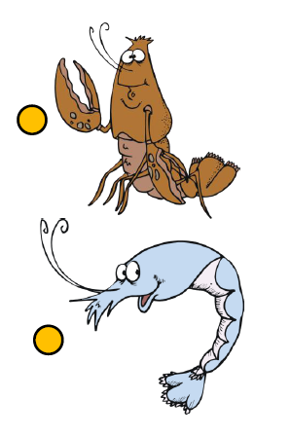



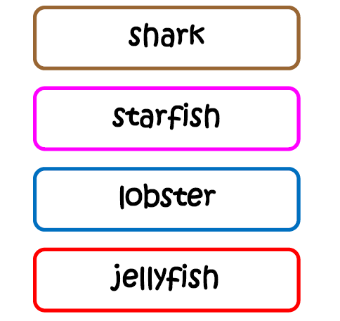
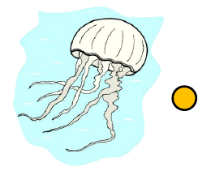
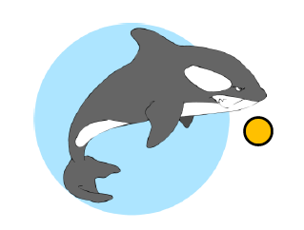
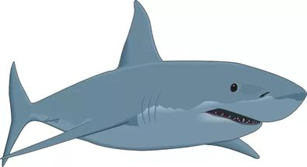

Slide 13
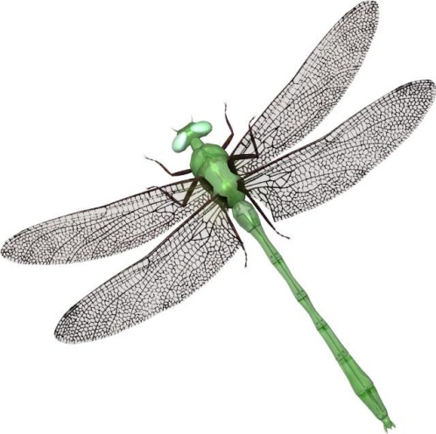
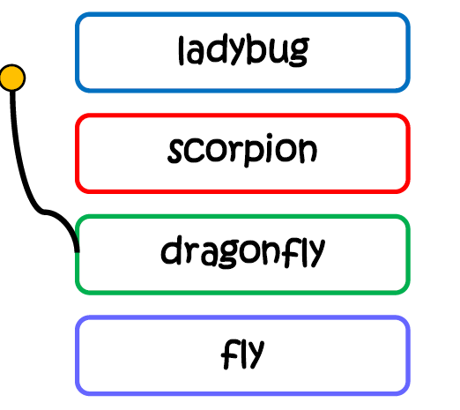
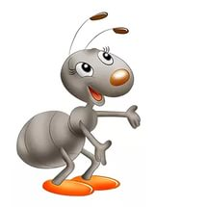

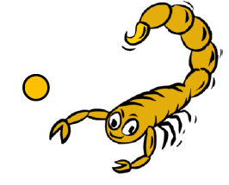
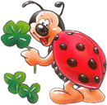
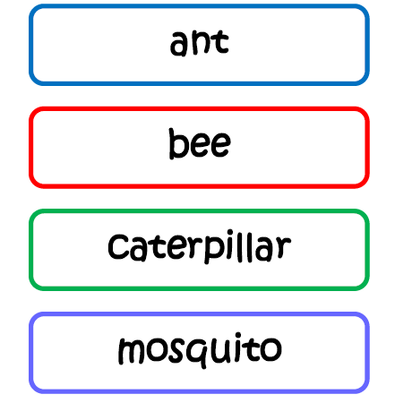
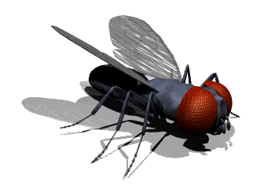

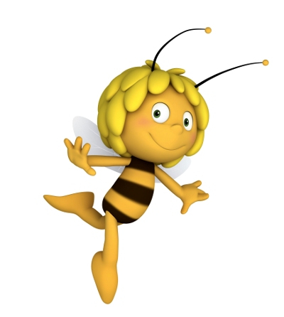


Slide 14









Slide 15
A hare and an apple
It was late autumn. The sky was grey. There were no leaves on the trees. But one red apple hung on the top of an apple-tree. A hare was running by and saw the apple. But he could not get it! Suddenly the hare heard: “Crow, crow!” The hare looked up and saw a big black crow. Не was sitting on the top of the tree.
“Hey, Crow!” said the hare. “ Pick that apple for me, please.”
The crow picked the apple, and it fell to the ground.
“Thank you, Crow!” said the hare. He wanted to take the apple, but the apple began to run away!
The hare opened his mouth: “ What is it?” Suddenly he saw a hedgehog. The apple was on his back.
The hedgehog stopped and said: “ It is my apple. I caught it when I was sleeping under the tree.”
“But I saw it first!” сried the hare. “The crow picked it for me.”
“No! It is my apple,” said the hedgehog.
The hedgehog and the hare began to fight.

Slide 16
The crow heard the noise and flew down to the ground.
“It is my apple because I have picked,” he said.
The bear heard the noise and came up to them.
“Shame on you,” he said. “What are you fighting for?”
The crow, the hare and the hedgehog said to him: “Mr Bear! You are the
biggest and the cleverest in the forest. Tell us what to do. Who must have the
apple?”And they told the bear about the apple. The bear thought and thought.
“Well,” he said, “each of you must have the apple.”
“But we have only one apple!” cried the crow, the hare and the hedgehog.
“Then you must cut the apple into equal pieces,” said the bear.
Thank you, Mr Bear,” they said. And the hedgehog cut the apple into four equal pieces.
“This piece of the apple is for you, Hare, because you first saw the apple”.
“This piece of the apple is for you, Crow, because you picked the apple.”
The hedgehog put a piece of the apple into his mouth and said: “This piece of the apple is for me because I caught it. And this is for you, Mr Bear.”
“For me?” cried the bear. “What for?”
“Because you taught us not to be greedy,” said the crow, the hare and the hedgehog.

Slide 17
THANK YOU!

